Slide 1
Relevance of IFRS & BASEL NORMS in Global Economy
Presented by:- Vaibhav Agrawal
Karthik Vaibhav

Slide 2
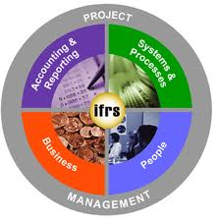
About IFRS
Accounting framework that establishes measurement, presentation & disclosure requirements relating to the transaction
of events that are reflected in the financial statements.
Framework developed by International
Accounting standards board in 2001.

Slide 3
Why IFRS

Slide 4
Benefits of convergence

Slide 5
Benefits of convergence(cont.)

Slide 6
FOREX accounting
Effect of change in exchange rates
Integral and non integral foreign operations-no distinction is made and all the transactions including gains and losses must be made in the functional currency.
Translation to the presentation currency

Slide 7
Mergers and Acquisitions accounting
IFRS provides clear guidelines to both
amalgamations and to acquisitions.
Use of pooling interest method is disallowed
under IFRS –firms should use purchase method difference in goodwill.
Goodwill amortization is prohibited under IFRS.

Slide 8
Effect of convergence on certain aspects of the industry
Profits
Reporting will be much more objective and transparent
Profits may shrink in the short run but will recoup once they get settled in the new system

Slide 9
Effect of convergence on certain aspects of the industry (cont)

Slide 10
IT sector
IT relies more on intangible assets and
human capital than fixed assets.
Simultaneous sale of License, Service
contract and Software development are
common in IT.
Revenue recognition currently done by the ‘Intrinsic Value method’ needs to shift to the fair value method as prescribed by IFRS.
Profits will reduce and hence ESOP options will be reconsidered

Slide 11
Banking sector
Banking sector is highly regulated in
India owing to the strict norms of the RBI
Interest on loans-accrued vs effective
annual rate of interest.
Interest recognition on NPA’s.
IFRS makes it mandatory for banks to disclose their credit, market and operational risk in their financial statements

Slide 12
Empirical Analysis

Slide 13
Challenges to convergence

Slide 14
BASEL NORMS

Slide 15
BASEL II PILLARS

Slide 16
CREDIT RISK

Slide 17
MARKET RISK

Slide 18
OPERATION RISK

Slide 19
BENEFITS

Slide 20
CHALLANGES

Slide 21
CHALLANGES (Cont.)

Slide 22
CHALLANGES (Cont.)

Slide 23
CHALLANGES (Cont.)

Slide 24
SIMILARITIES
Both the frameworks aim to move away from a narrow and perspective to a more broader approach that focuses on institution own assessment and management of Risks.
BASEL II encourages improvements in risk management and IFRS aims to link it with the firm’s capital structure.
Risk is an integral element of IFRS financial statements both in extending the scope of disclosure and in seeking to ensure that what is presented reflects the information used by management.

Slide 25
DIFFERENCES

Slide 26
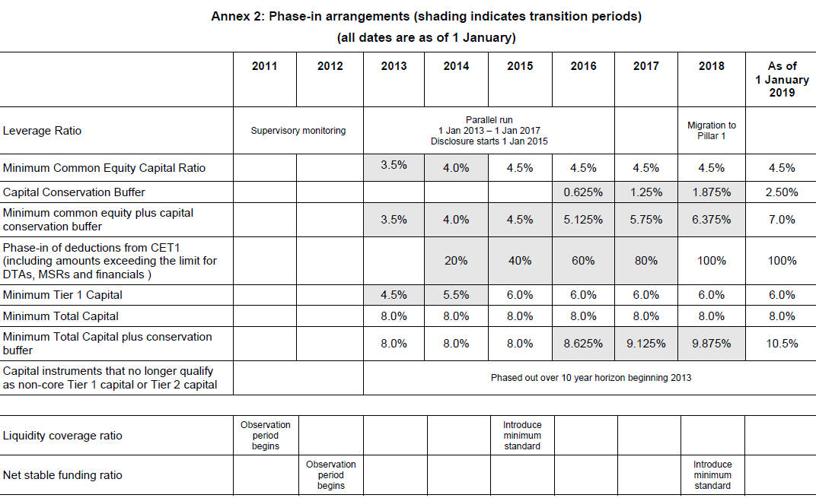
Empirical Analysis

Slide 27
Empirical Analysis

Slide 28
No Regret Moves

Slide 29
Balance-sheet Restructuring

Slide 30
Business Model Adjustment

Slide 31
References
International Research Journal of Finance and Economics - Issue 23 (2009)
IFRS - a step towards BASEL II and Solvency II Implementation? by John McDonnell
www.in.kpmg.com
www.ey.com/in/en/issues/governance_and_reporting/ifrs
http://ifrs.icai.org
http://www.mckinsey.com

Slide 32
Thank You for Your TIME

