Slide 1
Arjun N Kumanduri
PGDM B
I year
Notes:
Email: kanarjun@gmail.com

Slide 2
Agenda
100 % Book Building
French Auction
Reverse Book Building

Slide 3
Conditions
Net tangible assets >= 3 Cr in preceding 3 yrs
Track record of distributable profits >= 3 yrs
Net worth >= 1 Cr
Proposed issue > 5 X pre-issue net worth
Change of name, 50% of revenue earned should be due to the change for 1 yr
OR
QIB is allotted at least 50% of the issue (100% Book Building)
Post-issue capital >= 10 Cr. (or) Issuer undertakes market making for >= 2 years.

Slide 4
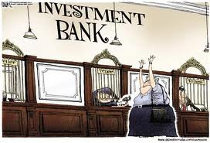
Roles of an IBanker
Investment Banker
Book Running Lead Manager
Syndicate Member
Chief Underwriter

Slide 5
Hierarchy of the Syndicate
BRLM
Syndicate Members
Sub Syndicate Members
R
E
A
C
H
R
I
S
K

Slide 6
Underwriting
Issuer
BRLM
Intermediaries
Underwriting Agreement

Slide 7
Investor Categories
Investors
QIB
NIB
Retail
FII
MF
FI
EMP
IND
HUF
EMP
IND
HUF
Anchor Investors

Slide 8
Concepts (Book Building)
Issue Size
Price Band
Bid Lot
Cut-off Price
Escrow Account
Subscription Period
Market Extension

Slide 9
Formalities
Appointment of Ibankers and Intermediaries
Filing due diligence certificate with SEBI
Filling of DRHP with SEBI 30 days prior to filing of RHP with RoC, and filing letter of offer with BSE and NSE
SEBI may specify changes – within those 30 days
In-principal approval from NSE/BSE
CC to SEBI
DRHP to be made public for at least 21 days after filing. Open for comments from public.

Slide 10
Simplified Price Discovery
Bid Quantity | Bid Price | Cumulative Quantity | Subscription
500 | 24 | 500 | 16.67%
1,000 | 23 | 1,500 | 50.00%
1,500 | 22 | 3,000 | 100.00%
2,000 | 21 | 5,000 | 166.67%
2,500 | 20 | 7,500 | 250.00%

Slide 11
Allotment and Refund
Allotment of shares, refund of money – within 12 working days from closure
Interest will be paid in case the money is not refunded (usually 15% p.a.)
Registrar to the issue - accountable for this purpose

Slide 12
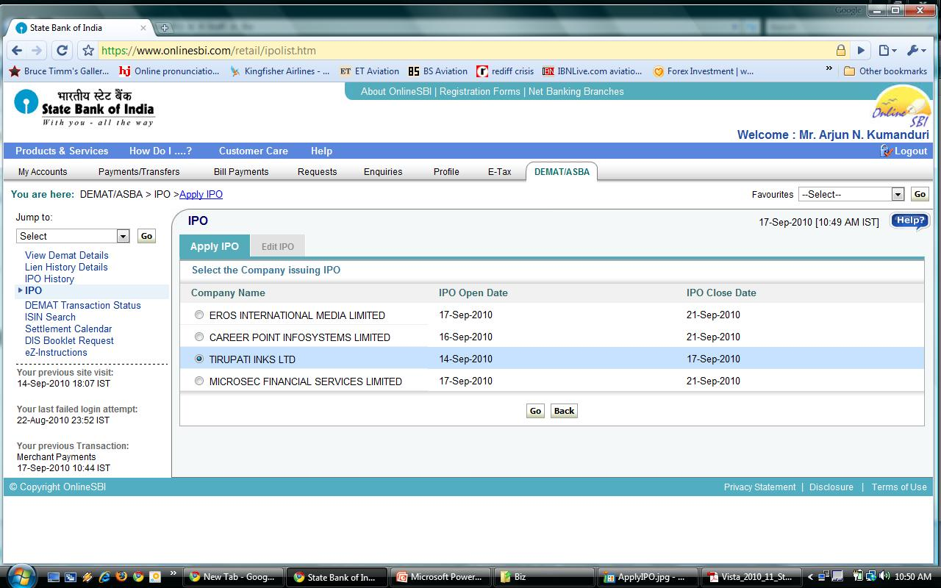

Slide 13
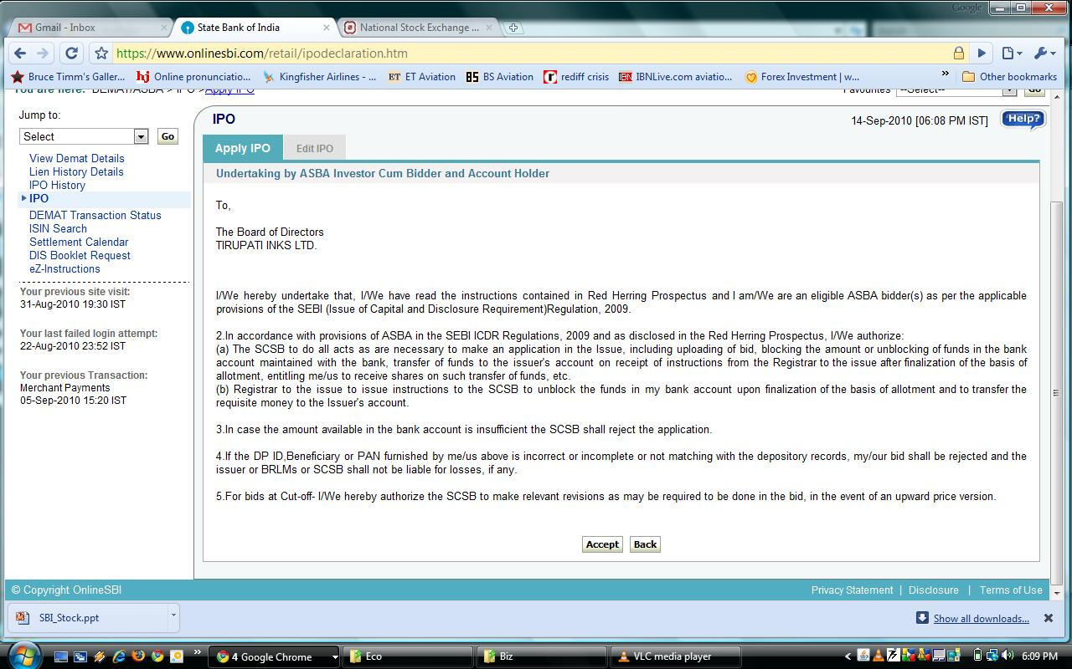

Slide 14
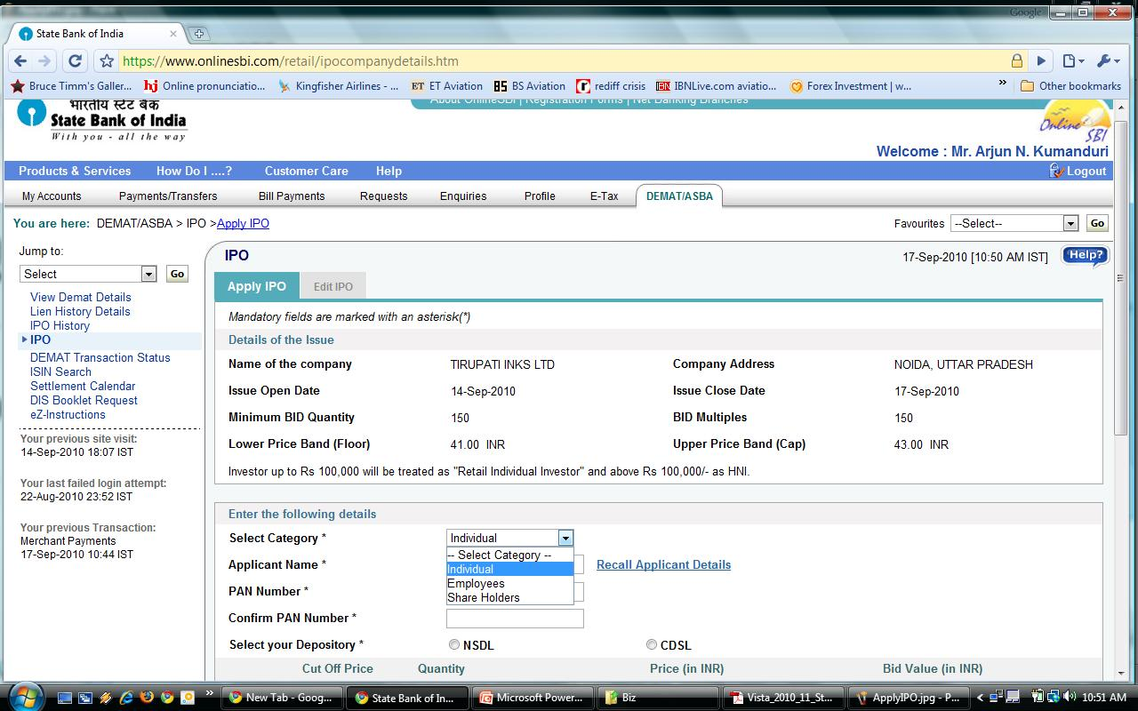

Slide 15
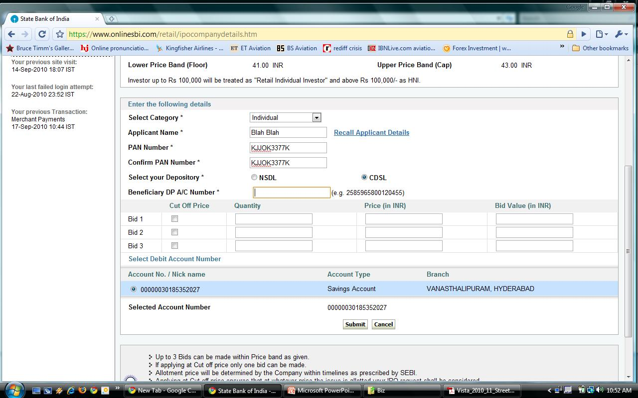

Slide 16
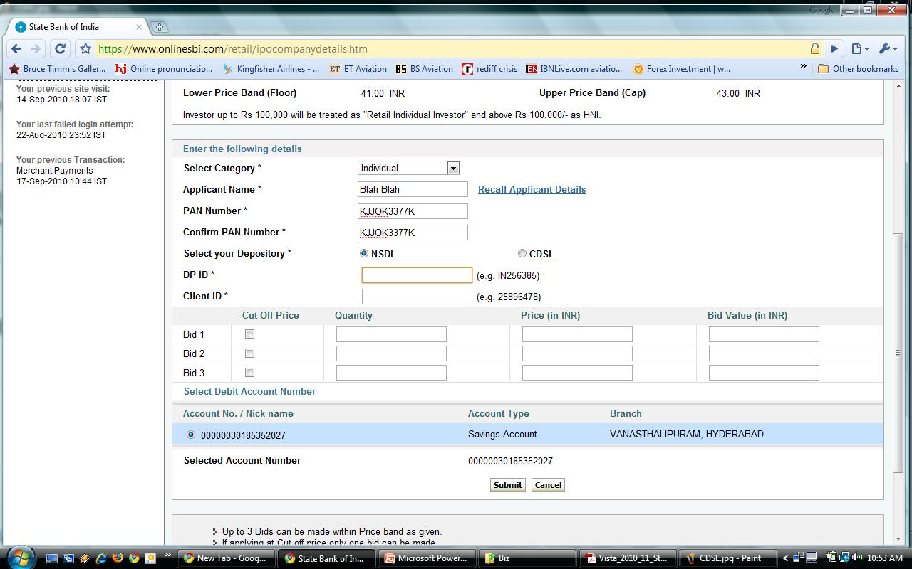

Slide 17
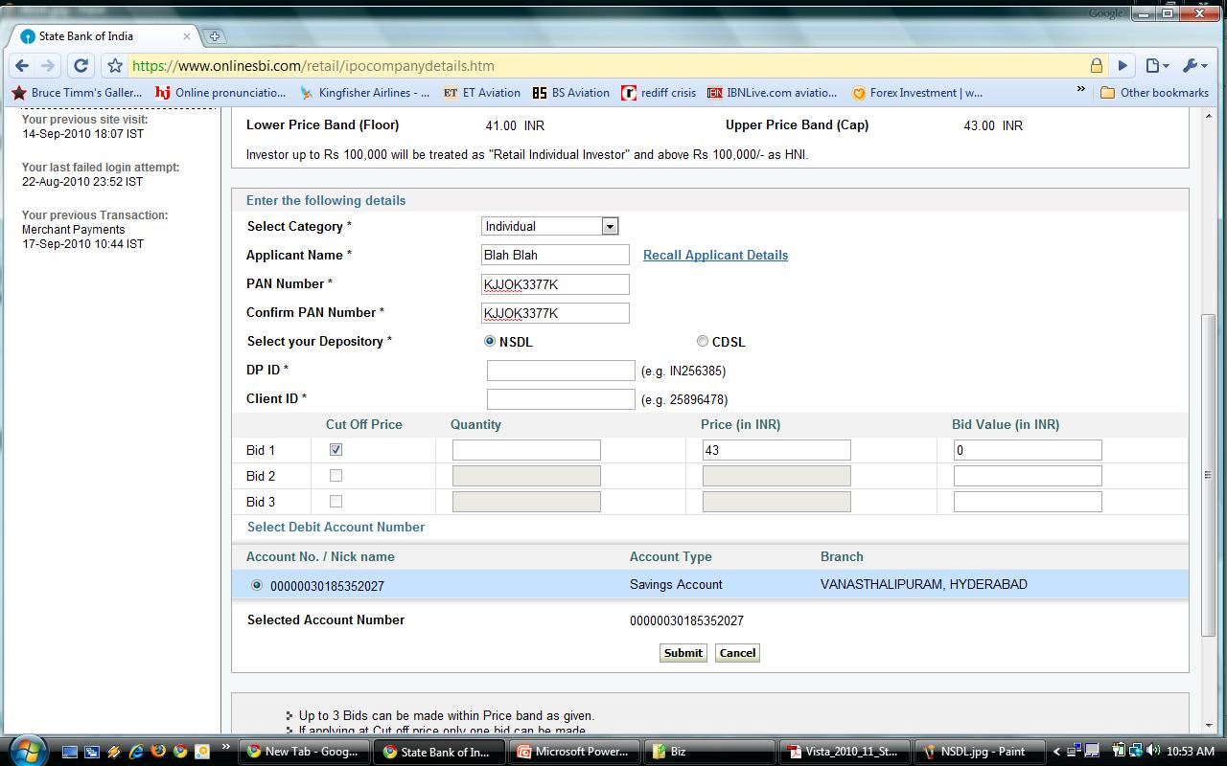

Slide 18
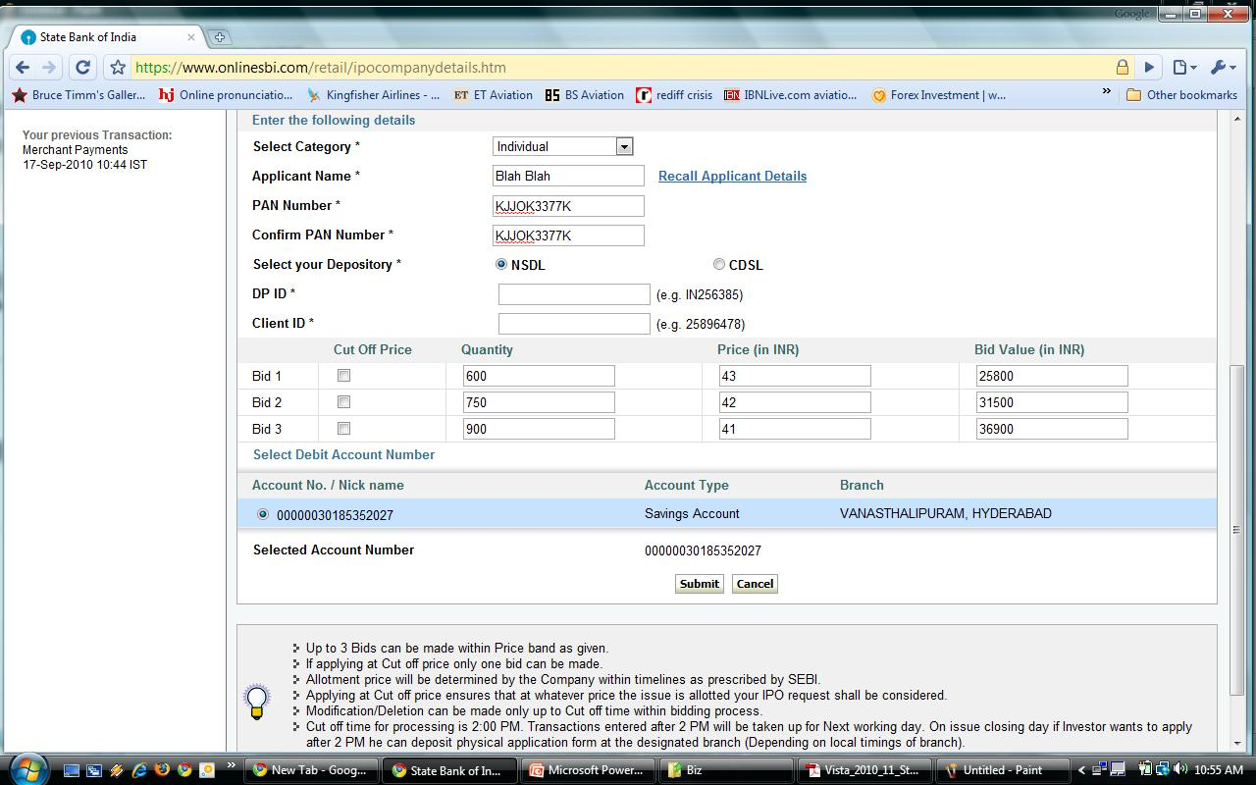

Slide 19
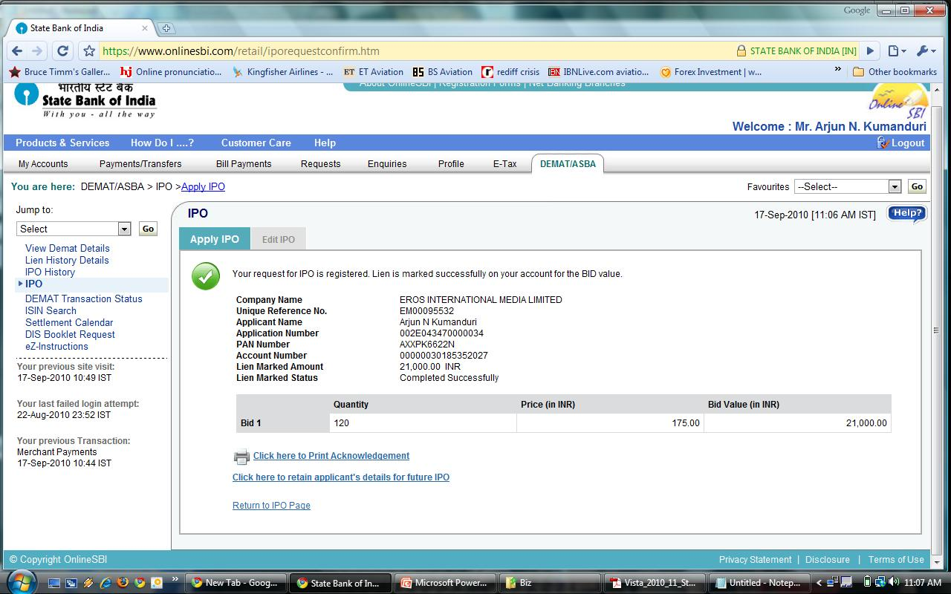

Slide 20
Green Shoe Option (GSO)
Price stabilisation – stabilising agent (SA)
115% of the issue is allotted, 100% is fresh issue while 15% is borrowed from promoters
Post listing if market price is below offer price, SA buys shares at offer price and gives them back to the promoters
Else, if the market price is above offer price, GSO is exercised by the issuer.
Appropriate disclosures are to be made in the RHP while filing with SEBI

Slide 21
French Auction
First used with NTPC and then with REC FPO
Only a floor price exists – No theoretical cap
Retail investors bid at cutoff; i.e. floor price
Others bid at any price above floor
Highest bidder in descending order would get preference in allotment
Revision of bid subject to certain norms
Allotment in differential prices

Slide 22
Reverse Book Building
Reverse
Purpose of delisting or acquisition
Minimum offer price – floor price
No cap price
Final offer price – through price discovery
Escrow Mechanism exists
Lot size is 1

Slide 23
That’s all folks!!
Questions?

